Slide 1
Continuous Delivery Redefined
Michael Pepe
Principal Consultant, Technical Sales
April 2015

Slide 2


$177B
“Software is eating the world”
Public cloud services market expected to grow 16% in 2015 to $177 billion¹
- Marc Andreeson
Wall Street Journal, Why Software is Eating the World, August 2011
welcome
to the
268B
Application Economy
By 2017, mobile apps will be downloaded more than 268 billion times²
50%
By 2018, more than 50% of B2B collaboration will take place through Web APIs³
¹ Gartner Forecast: Public Cloud Services, Worldwide, 2012-2018, 4Q14 Update, Ed Anderson, et al, 10 April 2015
² Gartner Hype Cycle for Application Development, 2014, Thomas E. Murphy, et al, 29 July 2014
³ Gartner Press Release, “Gartner Says by 2017, Mobile Users Will Provide Personalized Data Streams to More Than 100 Apps and Services Every Day” January 22, 2014 http://www.gartner.com/newsroom/id/2654115
¹ Gartner Forecast: Public Cloud Services, Worldwide, 2012-2018, 3Q14 Update, Ed Anderson, et al, 29 September 2014
² Gartner Hype Cycle for Application Development, 2014, Thomas E. Murphy, et al, 29 July 2014
³ Gartner Press Release, “Gartner Says by 2017, Mobile Users Will Provide Personalized Data Streams to More Than 100 Apps and Services Every Day” January 22, 2014 http://www.gartner.com/newsroom/id/2654115
Notes:
All organizations are thinking and becoming more like “tech” companies and digital business capabilities are beginning to dominate every industry. As a result, everything is moving more quickly as companies try to achieve first-mover advantage or become fast followers.
Every company in order to survive and grow will need to become a technology company.
Every business will need to become a digital business.
In today’s application economy, every business is a digital business – whether that’s retail, media and entertainment, finance and banking, communications or healthcare – literally everything is driven by an always connected, mobile, application-based world, where consumers are far more likely to experience your brand and engage with your enterprise through a software application than a person. And of course it’s also happening in the public sector, where government agencies are building citizen-centric applications and services….
So welcome to the Application Economy
<<Click>> In 2011, leading venture capitalist and co-founder of Netscape, Marc Andreessen wrote a seminal paper for the Wall Street Journal. Titled “Software is Eating the World”, Andreessen argued that more and more major businesses and industries are being run on software and delivered as online services—from movies to agriculture to national defense.
He argued that with lower start-up costs and a vastly expanded market for online services, we’ve arrived at a global economy that for the first time will be fully digitally wired— the Application Economy
….he wasn’t wrong
So what’s driving this new world – what can make every business, even yours – a software business <<Click>>
Well, firstly the cloud of course which has lowered the cost of entry. Fifteen years ago the cost of running a basic internet based software application was more than $100,000 a month, now with the cloud, I can run same application for less than $500 – and what’s more I only pay or what I use. Little wonder that spending on public cloud services exceeded $177B billion worldwide in 2015
What’s also exciting is how APIs have become a primary customer interface for technology-driven products and services and a key channel for driving revenue and brand engagement. Many leading companies have recognized this of course, like for example saleforce.com who generates half of its revenue through API’s and not traditional user interfaces – they’re not alone – Twitter processes 15 billion transactions every day through API’s and Amazon close to a trillion. Perhaps no surprise then that by 2016 analysts predicts that half of B2B collaboration will be driven by through API’s
Add to this, the estimated 268 billion mobile apps that will be downloaded by 2017 ( and we have a perfect storm – low cost cloud services and extreme mobility – where every individual with smart phone can access the full power of the Internet and potentially engage with your brand, every moment of every day.
To thrive in this new reality, developing and delivering applications that drive superior user experiences and engage your customers and staff is the new business imperative.

Slide 3




Applications Are Changing the World of Business
84%
$142B
140M
$13B
Video – US internet traffic by 2018
Volume of US Mobile-based payments by 2019
Number of Uber rides last year
AirBNB Market valuation
SO WHAT’S THE PROBLEM?
Notes:
Examples of this new application economy are everywhere, and they are changing the world of business.
In the entertainment industry, applications like Netflix and Hulu have already transformed video, and are becoming the new standards. According to research from Cisco, Video will may make up 84 percent of internet traffic by 2018
In the payments industry, smartphone applications like Square and Google Wallet are challenging the dominance of traditional banks and credit cards. According to analyst research (Forrester) – the volume of US mobile-based payments is expected to reach $142 Billion by 2017 – up from the $50billion today
In the transportation industry, software-driven services like Uber and Lyft are rewriting the world of taxi and limo services. Last year for example there were approximately 140 million Uber rides…that’s driven by software eating traditional taxi call-center based services
In the hospitality industry, services like AirBnB and Homeaway are upending the tradition hotel and accommodation business – for example the current valuation of AirBNB is said to be $13B – that’s more than two of the largest publicly-traded hotel chains. Wyndham Worldwide has a market capitalization of $9.8 billion and Hyatt Hotels Corp. is worth $9.2 billion….not bad for a company founded in 2008

Slide 4


Expectations Are Changing
UNPRECEDENTED SPEED
EXCEPTIONAL CUSTOMER EXPERIENCE
94%
25%
of executives face increased pressure to release apps more quickly
of users will abandon a web application after just three seconds of delay
2015 Vanson Bourne study commissioned by CA
Source: Reaching the Top of the Web Performance Mountain
Notes:
The application economy means new and unprecedented demands for IT organizations and expectations continue to grow. Living up to these expectations is a tremendous struggle for many, and may require updating, revising or replacing infrastructure, app design, service delivery, IT skills, technology assets or even business models.
Customers expect to connect with companies via software for fast easy access to products, services, and information.
If your company isn’t meeting these expectations, your customers are likely to go elsewhere.
In the application economy, external, revenue-generating customers are the most influential stakeholders.

Slide 5
DELIVERED RAPIDLY
HIGH- QUALITY
RESILIENT
High Performing Application Economy Leaders’ Competitive Advantage
30X
106%
68%
More code deployments¹
Higher revenue growth²
Higher profit growth²
1 Puppet Labs “State of DevOps”
2 ”CA Application Economy Market Study” commissioned by CA, conducted by Vanson Bourne, 2014
Notes:
The application economy means new and unprecedented demands for IT organizations and expectations continue to grow. Living up to these expectations is a tremendous struggle for many, and may require updating, revising or replacing infrastructure, app design, service delivery, IT skills, technology assets or even business models.
Application Economy Leaders have figured out how to make the necessary transformations. They are able to rapidly deliver apps – in some cases they deploy code 30 times more frequently than their lower-performing counterparts. And they deploy more resilient, high-quality apps that enable them to win, keep and serve their customers to achieve 106% higher revenue growth and 68% higher growth in profit.
Leaders in the Application Economy are significantly out-performing laggards across all business metrics
*Leaders and Laggards were determined by CA and Vanson Bourne based on respondents’ answers to three survey questions:
Whether they feel their organization is very/highly effective in managing the challenges of the application economy
Number of customer-facing applications developed in the past year
Whether they had already acquired or have near-term plans to acquire a software company to gain needed expertise.
We found a distribution of 24% leaders, 16% laggards, and 60% in the middle.
¹ Source:
Leaders:
Revenue growth= 35% (106% higher than 17%)
Profit growth = 32% (68% higher than 19%)
% New business = 36% (50% higher than 24%)
Laggards:
Revenue growth= 17%
Profit growth = 19%
% New business = 24%

Slide 6




What are high performing organizations doing?
VOLUME
VELOCITY
MONETIZED
Expedia
20M
Every 11.6
$2B a year
Lines of code: just navigation
Seconds code released
Via API’s / 90% of business
8,000
1,000+
10x traffic
Software developers
Deployments / Hour
Software API’s –v- Web
Notes:
Pete’s additional notes:
High performing organizations are doing three things:
1) Producing massive VOLUMES of code to differentiate their products and services. Like for example Mercedes, where the Model S Class of vehicle has 20 million lines of code for just for the onboard navigation system (that’s more than the new Boeing 787 Dreamliner with a ‘lazy’ 6.5 million lines). And like General Motors who have over 8,000 software developers….
2) High performance isn’t just measured by the quantity of software produced, it’s also measured by VELOCITY – or the ability to deploy it quickly and efficiently….like for example Amazon
Amazon is a great example when it comes to the power of efficient application delivery and the shift to CONTINUOS DELIVERY of code.
You are all familiar with Amazon’s personalized recommendation service. When they initiated it was seen the epitome of the power of digital coupled with big data. Capturing a customer’s history and activity it allowed Amazon to a deliver a service that was highly personalized, relevant, contextual and immediate.. It’s accounted for billions of dollars in additional revenue and captured sales. To do this Amazon releases code into it’s production environment every 11.6 seconds.
Continuously delivering changing code into their production systems - they are doing 1000s of deployments an hour, missing out traditional pre-prod staging environments on the way. It’s services like this that are forcing the whole SDLC to change and become one of Continuous Delivery. It’s all about getting an idea/innovation converted into customer experience in the shortest time possible.
Facebook is another great example. A custom Web page is built every time you visit. It pores over all the actions your friends have taken—their photos, their friends, the songs they listen to, the products they like—and determines in two-hundredths of a second which items you might wish to see, and in what order.
Facebook is continuously introducing new features and functionality. Arguments about whether or not a feature idea is worth doing or not generally get resolved by just spending a week implementing it and then testing it on a sample of users, e.g., 1% of Nevada users.
Facebook is also obsessed with A/B testing, where engineers compare one version of a Web page to another to see which generates the most interest. You might make one version of a menu red and another blue, then run data analysis to gauge their performance. At any given moment, Facebook has tens of thousands of A/B tests running. It may be trying to decide which version of an ad plays best to a particular crowd or how to word the options in a menu. This is how Facebook discovered that people got stressed out and left the site when they were asked if they wanted to “reject” a friend request. The engineers found the noncommittal “not now” kept people logged on.
….and finally, high performance organizations take this ability to code and deliver rapidly to grow and disrupt their markets. Like for example Expedia who generate $2Billion a year in revenue through software APIs….that’s 90% of their business…and Twitter where the amount of traffic reaching their business from API’s is 10X that of the Web.

Slide 7



What are Challenges that Companies are Experiencing?
DEVELOPMENT
OPERATIONS
SPEED
STABILITY
Customer
Experience
Agile, Lean
ITIL, process, SLA’s
Bring features/products to market faster
Ensure availability; MTBF
Cloud, open source, infrastructure-as-code
Legacy and proprietary apps/infrastructure
Notes:
But most organizations are not as progressive as Amazon or Facebook. In any organization with a separate operations department, and especially those with an independent QA or testing function…most of the pain in getting software delivered is caused by poor communication between these groups, exacerbated by a cultural divide and conflicting goals. Dev teams are measured on speed and throughput, and ops teams are measured according to stability. Testing and release management teams are often caught in the crossfire between dev and ops teams.
Ultimately, everyone is trying to accomplish the same goal, to create business value through software - but everyone needs to get better at working together toward this goal rather than trying to optimize our own domain.

Slide 8
DevOps Transforms People, Process AND Technology
DEVELOPMENT
OPERATIONS
SPEED & STABILITY
Customer
Experience
Communication and shared metrics and goals - driving business value
Collaboration and Continuous Feedback
Technology toolset enabling DevOps
Notes:
DevOps challenges the traditional view that development’s primary role is to add new features, and operations’ primary role is to make sure the environment is stable, and fast. The premise of DevOps’ philosophy is that the goal of both development and operations is to make sure their business thrives in the application economy.
Connecting development, test and ops teams by establishing shared responsibilities, common goals and engineering practices are critical hurdles, but having the right tools in place is equally essential to delivering high quality software, fast. Unfortunately, most organizations aren't set up for success…

Slide 9


Traditional “Software Factory”
Developers Deadlocked
Constrained Environments
Manual
Testing
Too little testing, too late in the cycle
Too many disparate tools
Manual
Scripting
Poor customer experience
Customer
Experience
Work Time
Wait Time
IDLE TIME
DELAYS
DELAYS
DELAYS
IDE
SCM
CI
CONTAINER
TEST
CONFIG
CLOUD
PROVISION
Code | Integrate | Build
defect
Functional & UA Testing
defect
Performance Testing
defect
Deploy to Production
DEV
QA/TEST
PRE-PROD
PRODUCTION
RE-WORK
RE-WORK
RE-WORK
SLOW AND INEFFICIENT - EXCESSIVE IDLE TIME, DELAYS AND RE-WORK
Notes:
Nearly every organization today is struggling to deliver what the business needs, when the business needs it. The traditional “software factory” or process for transforming an idea a customer experience is throttled by a number of bottlenecks in the delivery pipeline.
<build 1> Different development teams typically work on different interdependent parts of the app, so dev teams often sit idle waiting for other components to be completed.
<build 2> As development teams crank out multiple CI builds every day, these builds also need to be tested and validated so that they can move through the pipeline. Manually creating and configuring the necessary environments takes a lot of time and effort, creating a bottleneck in the process.
<build 3> Constrained environments can force difficult decisions, rather than delay the project, teams are often forced to move forward anyway, delaying testing until the end of the cycle, when errors and defects require significantly more re-work than if they’re found early in the cycle. Test environments are rarely provisioned with the necessary test data to create a real-world ‘production-like’ environment. So even when the environments are available, they may not yield the most accurate results and testing is done manually, which means further delays.
<build 4> There are multiple teams involved in the delivery process – dev, test, release management, operations – and each has their own set favorite tools they use to perform their tasks. These tools are constantly changing and new ones emerge on a regular basis.
Dev teams may use SCM tools like Git or TFS for file management and version control and Continuous Integration (CI) servers like Jenkins or Team Foundation Server (TFS) to monitor the SCM for changes and then launch the build process, as well as Nexus or Artifactory as a repository for managing artifacts. Some advanced development teams are using container tools, like Docker to package code for quick assembly and hand-off.
QA/Test teams use a variety of different testing tools to manage test data or to automate some aspects of testing.
Release Management or ops teams use configuration tools like Chef and Puppet, and many use cloud management tools and/or provisioning tools.
<build 5> These different tools don’t just automatically work together, so orchestrating all of the interdependent functions and writing manual scripts to manage how the tools interact, may actually take more time than they are meant to save.
<build 6> Time-to-market isn’t the only thing that is impacted by all this inefficiency – when errors or defects aren’t discovered until after an app is deployed to production, customer experience suffers, potentially damaging your brand.

Slide 10
Continuous Delivery
Developers Deadlocked
Constrained Environments
Manual
Testing
Too little testing, too late in the cycle
Too many disparate tools
Manual
Scripting
Poor customer experience
Parallel
Work Streams
Quality
Acceleration
End-to-end
Automation
Customer
Experience
Work Time
Wait Time
IDLE TIME
DELAYS
DELAYS
DELAYS
IDE
SCM
CI
CONTAINER
TEST
CONFIG
CLOUD
PROVISION
Performance Testing
Functional & UA Testing
Performance Testing
Deploy to Production
Code | Integrate | Build
Functional & UA Testing
Deploy to Production
Code | Integrate | Build
defect
defect
defect
DEV
QA/TEST
PRE-PROD
PRODUCTION
RE-WORK
RE-WORK
RE-WORK
TOOLING FOR HIGHLY AUTOMATED, END-TO-END SOFTWARE PIPELINE
Notes:
Continuous Delivery addresses all of these issues
<build 1> With service virtualization, teams can rapidly build and configure new environment instances to keep pace with Agile development cycles. Virtualizing services and APIs removes critical dependencies from the development process to ensure teams have what they need, when they need it, reducing constraints so that teams can work in parallel, dramatically reducing both work and wait time. This removes the developer deadlock and the environment constraints.
<build 2> Automatically generating test scripts speeds up the testing process and test data management solutions make it easy to create real-world ‘production-like’ environments, so testing is more thorough and more accurate, producing much higher quality results. Defects and errors are found and resolved much earlier the cycle so there is far less re-work downstream.
<build 3> With the right release automation solution, teams can easily plan and create a comprehensive release plan that incorporates all the tasks performed by third party tools. And with test automation, promotion from one environment to the next is automated and orchestrated to streamline the entire process.
<build 4> Simplifying build and configuration of new environment instances means testing can occur early and often. Defects and errors are found sooner in the cycle to significantly reduce re-work . Teams have easy access to the test data they need to create real-world ‘production-like’ environments that enable more thorough testing and yield more accurate results, so errors or defects are discovered long before an app is deployed to production, so there’s no negative impact to customer experience or your brand.

Slide 11

Parallel
Work Streams
Quickly create, edit and deploy virtual services
Accurately simulate dev, test and production
Virtualize APIs and manage access
CA Service Virtualization
CA App Dev Portal
CA Mobile Access Gateway
VIRTUAL SERVICE
API
Management
Document requirements
Design Spec
Customer
Experience
Plan Release
Set up dev environment
Set up test environments
Set up pre-prod
Code commit
SCM
CI/Build
Integration testing
Functional testing
UAT
Deploy to pre-prod
Performance testing
Deploy to production
DEV
QA/Test
PRE-PROD
PRODUCTION
ELIMINATE DEPENDENCIES AND CONSTRAINTS TO ENABLE PARALLEL WORK STREAMS
Notes:
Agile development practices create a constant demand for new environment instances and configuration changes so that code builds can be tested and validated. (CA Service Virtualization) Service virtualization makes it possible to quickly create and deploy virtual services that accurately simulate constrained environments, eliminating dependencies and delays and enabling concurrent, parallel work streams where different development teams can work on different features at the same time.
After virtualizing the behavior of API’s and services (with CA Service Virtualization), adding API management solution (CA API Management) will make it easy for developers to access API’s that have been published and secured. Working prototype APIs can be published and connected to virtualized backend web services, so developers can begin using as soon as they are available, rather than having to wait until it is complete and teams can work in parallel rather than sequentially.

Slide 12
Quality
Acceleration
Automatically generate test cases - across SDLC
Test on any
device or platform
mobile-to-mainframe
Extract real-world data to provision test environments
CA Continuous Application Insight
CA Application Test
CA Data Finder
VIRTUAL SERVICE
Document requirements
Deep Transaction Insight
Real World Data
Design Spec
Customer
Experience
TEST
PLAN
TEST
PLAN
TEST
PLAN
Plan Release
Set up dev environment
Set up test environments
Set up pre-prod
Set up prod
Code commit
SCM
CI/Build
Integration testing
Functional testing
UAT
Deploy to pre-prod
Performance testing
Deploy to production
DEV
QA/Test
PRE-PROD
PRODUCTION
Find defects here
…instead of here
SHIFT LEFT
Notes:
<build 1> (CA Application Insight) With the right analytics solution, one that observes the application to learn how it’s behaving, the knowledge can be used to automatically generate ‘production-like’ virtualized services that can be used for testing.
<build 2> These same analytics can be used to automatically generate test scripts that are not only more thorough to yield the most accurate results, they’re created much more quickly and without the extensive effort required to do it manually. With test automation (CA Application Test) you can rapidly design and execute automated unit, functional, regression, integration, load and performance tests.
<build 3> By simulating the behavior, data and performance of any system, you can create environments to test on any device or platform, mobile to mainframe

Slide 13



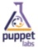


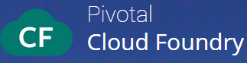
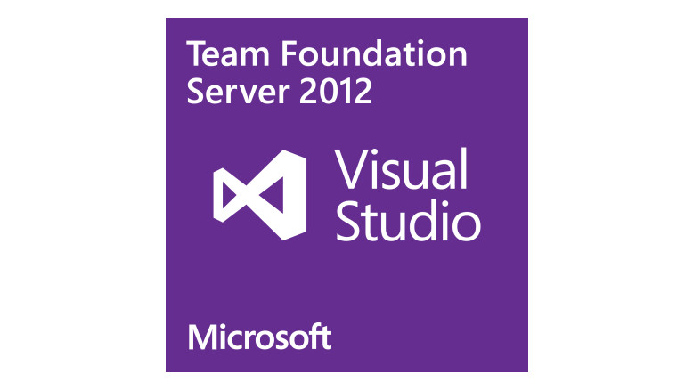






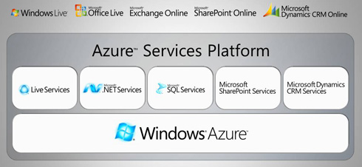

End-to-end
Automation
Integrate 100+ open source and 3rd party tools
Automate application deployment & promotion
Create continuous feedback loops
CA Release Automation
STREAMLINE AND ACCELERATE THE ENTIRE RELEASE PROCESS, REDUCE MANUAL EFFORT AND ERRORS
Document requirements
Design Spec
Customer
Experience
Plan Release
REP MGR
SCM
CI
CONTAINER
TEST
CONFIG
CLOUD
PROVISION
Code commit
SCM
CI/Build
Integration testing
Functional testing
UAT
Deploy to pre-prod
Performance testing
Deploy to production
DEV
QA/Test
PRE-PROD
release alert & details
PRODUCTION
APM
performance
snapshots
Notes:
<build > Dev teams use a variety of different tools to make their jobs easier…for example, repository managers like Nexus or JFrog’s Artifactory…
<build > or Git or TFS (Team Foundation Server) for file management and version control
<build > they might use a Continuous Integration (CI) system like Jenkins or TeamCity to monitor the SCM for changes, then launch the build process, taking the source code from the repository and running unit tests for validation.
<build > Some advanced development teams are using container tools, like Docker to package code for quick assembly and hand-off to QA/Test and production release teams in order to make sure their apps will run consistently as they move through the release process.
<build > For test automation, they may use tools like Selenium or Perfecto Mobile
<build > or an automation platform like Chef or Puppet to configure their infrastructure
<build > and they may use public cloud services from AWS or MS Azure or
<build > tools like VMware for provisioning
<build > The right release automation solution allows you to incorporate all of these different tools into a streamlined release plan that fully automates deployment and promotion of changes across all environments to compress the release process timeframe, reduce the risk of configuration based errors and the number of people required to manage each deployment stage.
<build > by integrating release automation with application performance management, you can establish continuous feedback loops of communication across teams; ops teams are alerted when code is deployed to production and receives a detailed description of the release, including who did what and when…so if an issue occurs, they’re able to easily see what changed when to quickly determine the root cause and remediate. On the ops side, the APM solution can monitor applications and provide performance snapshots to different stakeholders across the delivery cycle, providing visibility and insight into application behavior.

Slide 14
Continuous Feedback
Continuous Feedback
PERFORMANCE SNAPSHOTS
RELEASE ALERTS & DETAILS
Test
Automation
Release
Deployment
Environment Management
Production
CA Continuous Application Insight
CA Release Automation
CA APM
Dev/Test Integration
Production Data
Notes:
This slide needs to have a couple things done with it:
There needs to be a connection between “CA Release Automation” and “CA APM” to indicate a connection between the two – maybe double-end arrow? And some indication of “continuous loop”
Similar to above, there needs to be a connection between “CA Continuous Application Insight” and “CA APM” to indicate a connection between the two and a “continuous loop”
Indicate “Dev/Test Integration” and “Production Data” are part of the “continuous loop”; this loop could be separate “continuous loop” than the “loops” you create in 1) and 2) above; it could be a double-ended arrow between the two text boxes, perhaps there’s some movement to imply the loop is ongoing?

Slide 15



Real Companies. Real Results.
Up to
50%
AutoTrader
96% reduction in time required for one cycle of integration testing
25% reduction in software defects
$300,000 savings on environments
Reduction in application dev/test cycle
Up to
90%
More defects detected at least 1-step earlier in SDLC
http://bcove.me/gsornyww
Lloyds
Before … Took 5 people days to do 20 tests
AFTER … Takes 1 person one minute to do 20 tests
Save
$MMs
In infrastructure costs and 3rd party service fees
ING
Before … 150 deployments per month
AFTER … 30,000 deployments per month going too 50,000 by 2015
Sources: CA Service implementation scorecard results
Large US bank and US airline
Notes:
AutoTrader Avoids $300,000 in Testing Costs With CA Service Virtualization
Business: AutoTrader sells advertising that allows private and trade buyers and sellers to exchange vehicles. More than 18 million people use AutoTrader.com each month.
Challenge: To meet customer demand and provide a seamless service across different devices, AutoTrader must be able to release software updates on a weekly basis. Testing, however, had become complex, costly and time-consuming.
Solution: CA Service Virtualization enables AutoTrader to virtualize and test new services and apps on a multitude of devices. AutoTrader can simulate both apps working normally and performance issues.
Benefit: AutoTrader can deliver new features in a shorter timeframe and for a lower cost, which helps improve the customer experience and competitive advantage. It has reduced software defects by 25 percent and cut testing times by 99 percent.
By using CA Service Virtualization AutoTrader.com has been able to:
Cut integration time from three days to three hours
Save an average of 576 man-hours – or 2.5 people – per release
Avoid $300,000 in test hardware and software costs
Decrease software defects by 25%
At Lloyds bank today 2500 developers are using our Service Virtualization solution. This has lead to 33% reduction of their software development process. Where it used to take us five people days to do 20 tests. Now it takes one person and one minute to do the same. Furthermore they’re finding more defects in development, which like I said earlier is where they are cheaper to fix.
ING Bank Case Study: Improving time to market from 13 weeks to Less than 1 week with DevOps and Continuous Delivery practices
30,000 application deployments per month
5000 Agents deployed (managed systems)
Managing the deployment of approx. 300 applications with RA
Just 3 years ago, ING was doing 150 deployments per month and realized they needed to speed things up to stay competitive… to win, they had to dramatically improve. They turned to CA.
ING is now innovating and winning…they’re doing 30,000 deployments per month, and that number is growing on a daily basis. They expect to be at 50,000 by the end of 2015. When you talk about a shift in competing in the digital era, this is it. ING is now a high-performing organization that is able to continuously deliver innovation to the market.
Accelerated application release cycles from Months to Minutes
Increased frequency of releases by up to 300%
Deployment resources Reduced from 15 to 1 and save $14M annually
Over 120+ Integrations covering 1300+ Actions
Largest market presence in Application Release Automation market*
Molina Medicaid Solutions (MMS) Reduces Application Release Deployment Times from Several Hours to Less than 45 Minutes with CA Release Automation
Business: Molina Medicaid Solutions (MMS) is a wholly-owned subsidiary of Molina Healthcare providing business processing and IT administrative services to Medicaid agencies in five US states and one US territory.
Challenge: To improve quality and reduce cost, MMS needed to automate application release deployments for critical customer-facing solutions. Errors and extensive project timelines were exhausting resources, and inhibiting desired growth in the area of customer service.
Solution: CA Release Automation provides MMS with efficient, repeatable processes for application release and patch deployments to greater than 500 servers across 20+ complex software environments.
Benefit: Deployment time has been consistently reduced from over 12 hours to less than 45 minutes, dramatically decreasing resource requirements, human error, and significantly improving customer service.

Slide 16










Continuous Delivery REDEFINED
Parallel
Work Streams
Quality
Acceleration
End-to-end
Automation
Customer
Experience
Application Pipeline
CA Service Virtualization
CA App Dev Portal
CA Mobile Access Gateway
CA Continuous App Insight
CA Application Test
CA Data Finder
CA Release Automation
Notes:
Realizing DevOps requires the solutions/the technology to help organizations create a continuous pipeline of digital innovation.
To make this transformation, organizations need REDEFINED continuous delivery that eliminates development, environment, and testing constraints to enable parallel works streams and make testing faster and more efficient. And they need automation and orchestration across their entire toolset with continuous feedback with bi-directional communication capabilities.

Slide 17


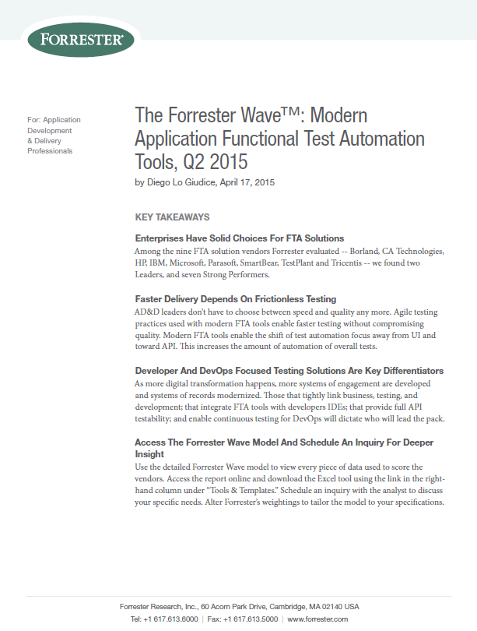
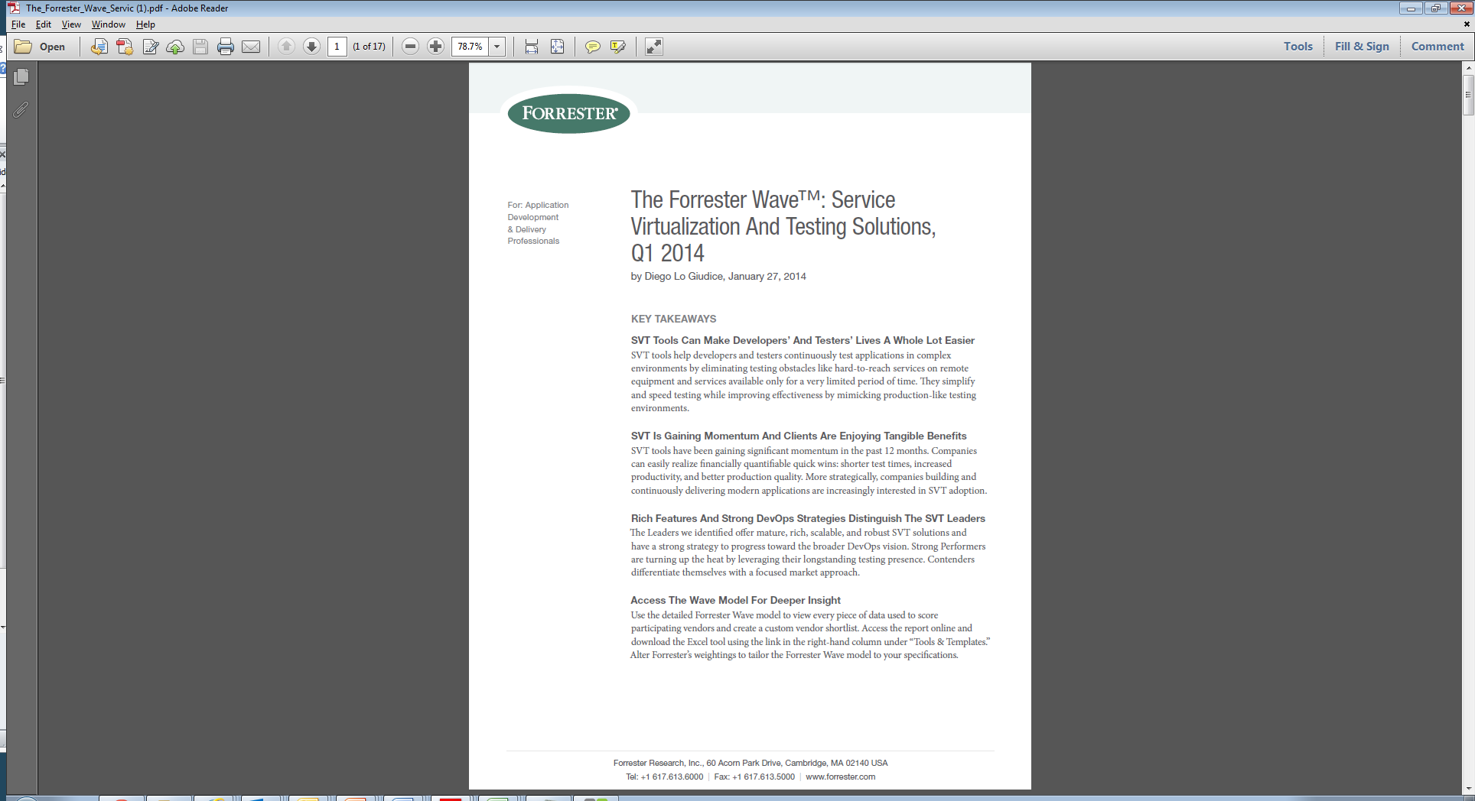
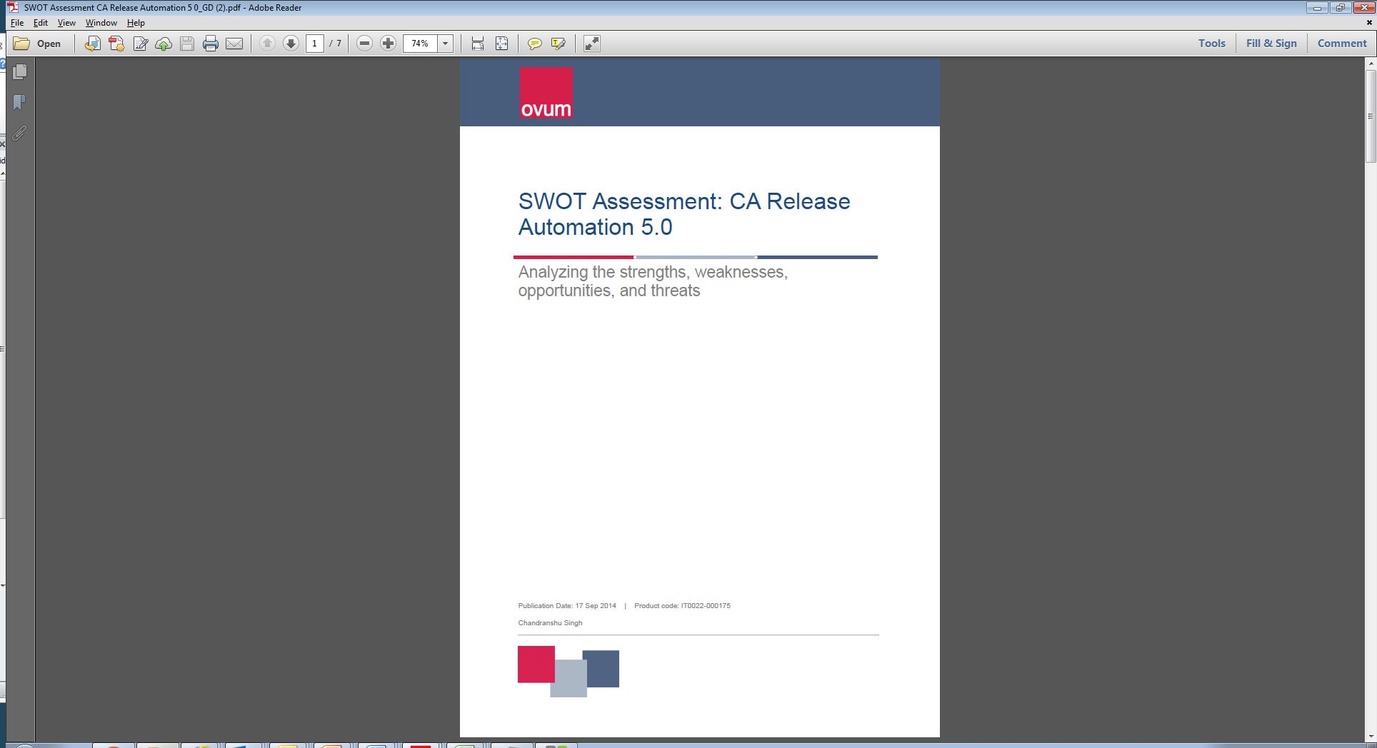
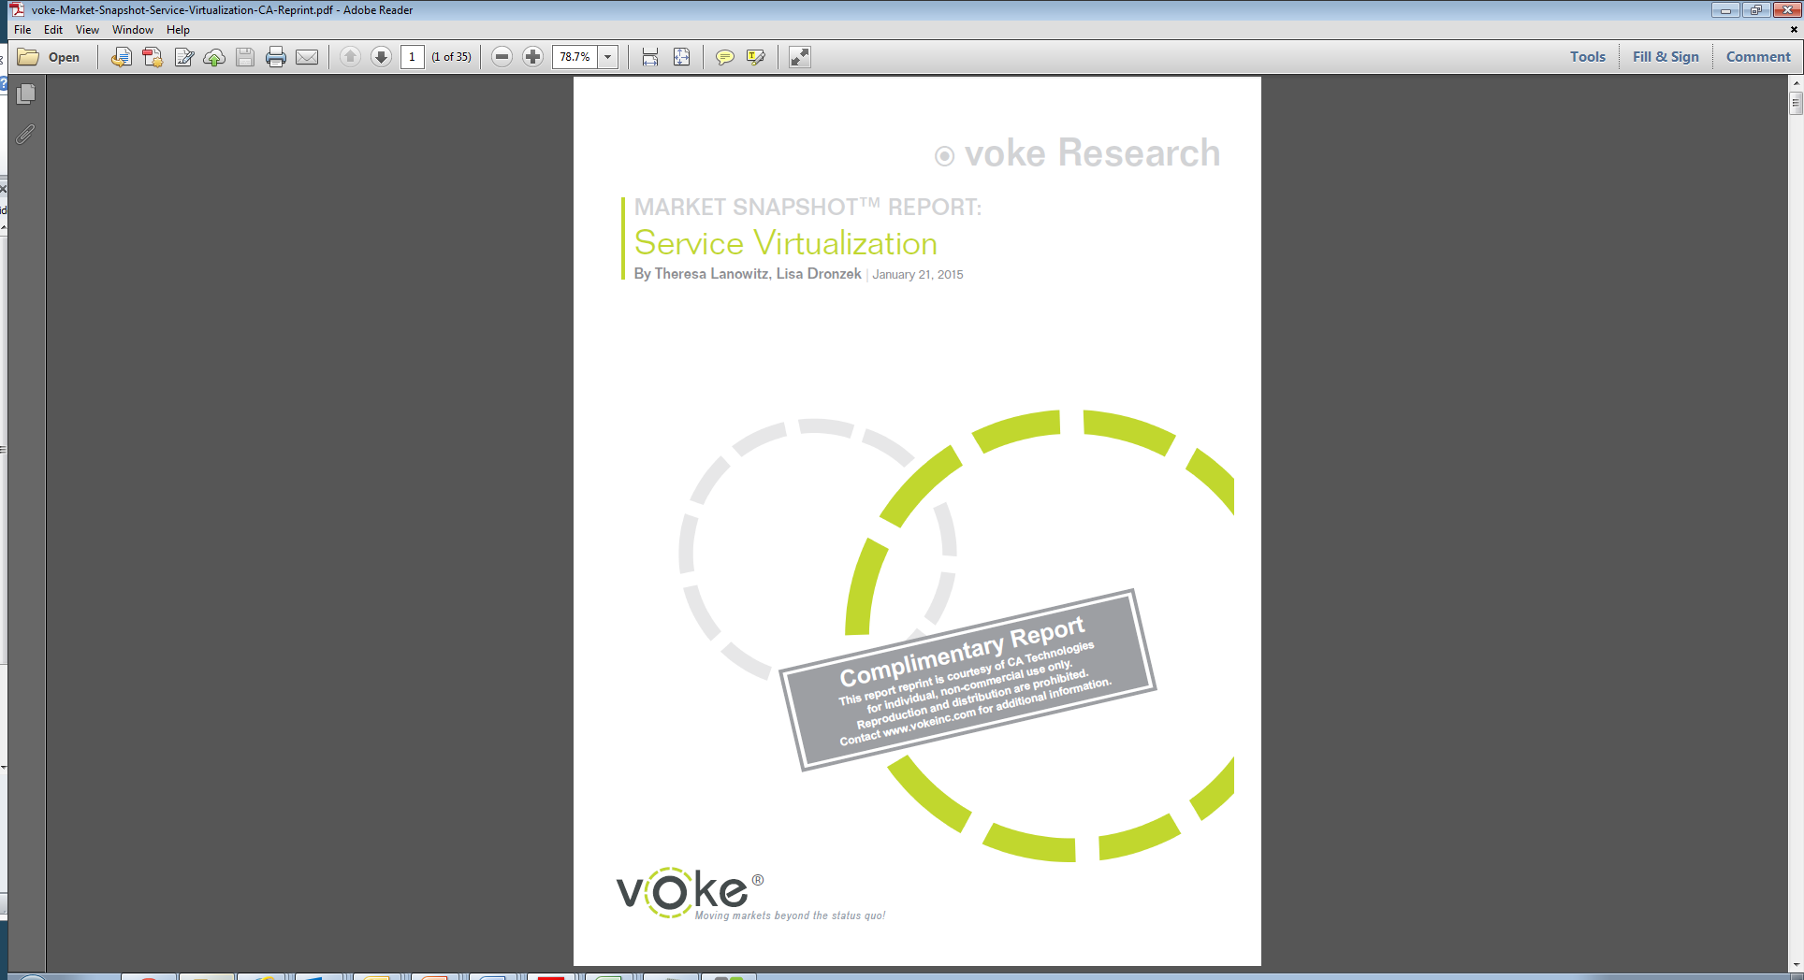

CA leads Continuous Delivery Market
MARKET RECOGNITION AND LEADERSHIP
“We could not do what we do without CA”
Industry analyst validation
Comprehensive integrated portfolio
Strong partnerships with top GSIs and ecosystem partners
Notes:
Industry Analyst Recognition
3-4 years ago, we could hardly get an analyst to talk about SV or RA. As the market matures, this technology is becoming central in the analyst community. The analyst interest is a key validation. Forrester, OVUM, and Voke have all recently published how our solutions must be short-listed to win in the application economy.
Comprehensive, integrated portfolio
No other vendor can match the depth and breadth of our open, integrated portfolio of Continuous Delivery solutions
Strong Partnerships
We are building strong partnerships with 8 of the 12 top Global Systems Integrators
Customer Validation
The passionate almost zealous commitment many of our customers have for us is truly inspiring.
Forrester - https://www.ca.com/us/register/forms/collateral/the-forrester-wave-service-virtualization-and-testing-solutions-q1-2014.aspx ‘
OVUM - https://www.ca.com/us/register/forms/collateral/ovum-swot-assessment-ca-release-automation.aspx
Voke Research - https://www.ca.com/us/register/forms/collateral/voke-market-snapshot-report-service-virtualization.aspx

Slide 18

Q & A

Slide 19
Improve Sales Execution | Objectives: Increase size of sales pipeline Improve velocity of early stage opportunities Reinforce how not to be single-threaded in a sales cycle Reinforce challenger sales behaviors to provoke action
 | May | June
Tribal Drums (Sales/Pre-Sales) | Conversation Series - Social Selling – Research and Creating a Platform for Change Using Social Selling - May 11 – (Don Perry) Conversation Series - Story-Telling, Creating Interest and Qualification - May 18 - (Mark Verstockt and Benny Van de Sompele) | Conversation Series - Setting Visions, Competitive Traps and Finding a Mobilizer - June 1 - (Andrew Plunkett, David Stokey) Conversation Series - Setting up For Proof and Implementation - June 8 - (Matt Cooke) Conversation Series - How Partnering Drives A Different Conversation - June 15 - (Gracie Golonka) Conversation Series - Proposals and Negotiation Best Practices - June 22 - (Jim Lucas, Don Perry)
Content on SWB | Interest Creation Tools Challenger Discovery Guide Application Delivery Story Sets Qualification Slides | Example Mutual Activity Plans ROI Calculator Get Give Lists Key Partner Summary

Slide 20
Ensure Core Product Understanding | Objectives: Stay abreast of latest releases, features, differentiation points and supporting assets Prepare and understand new product launches and how to position with customers and partners early Understand how services converts products into solutions
 | April | May | June
Tribal Tech (Pre-Sales) |  | Solution Sweep Series - Our Detailed, Technical Product Differentiators and Action Packs - May 11 - (Don Perry, Allison Cramer, Uri Scheiner) Solution Sweep Series - Driving Fast Implementations and Expansion Through Services Engagement Pre-Proof - May 18 - (Matt Cooke) Solution Sweep Series - Third Party / Open Source – Who Are the Players and What You Must Know - May 26 - (Mark Sigler) | Solution Sweep Series - Third Party / Open Source Session #2 – Who Are the Players and What You Must Know - June 1 - (David Cramer) Solution Sweep Series - CAI Momentum Update - June 8 -(Chris Kraus) Solution Sweep Series - CA Release Automation & Total Economic Impact Study - June 15 - (Uri Scheiner, Allison Cramer) Solution Sweep Series - CA Service Virtualization 8.5 - June 22 - (Stefana Muller) Solution Sweep Series - Communicating Technical Advantages and Positioning with PWC - June 29 - (Aruna Ravichandran)
Content on SWB |  | Competitive Differentiators Services Summary | Updated Level 1 Decks YouTube Demos

